Slide 1
Chapter 17
How to use jQuery Mobile
to build mobile web sites
Notes:
Session: Ghi số thứ tự session trong môn học
Session Name: ghi tên của session sẽ dạy
<number>

Slide 2
Objectives
How to work with mobile devices
An introduction to jQuery Mobile
How to use jQuery Mobile to create a mobile web site
How to format content with jQuery Mobile
How to use jQuery Mobile for page layout
A mobile web site that uses jQuery Mobile
Notes:
Mô tả nội dung mà học viên phải đạt được khi kết thúc môn học này
<number>

Slide 3
How to work with mobile devices
Notes:
Mô tả nội dung chi tiết từng chuyên đề
<number>

Slide 4
How to provide pages for mobile devices
At present, the best way to provide for mobile devices is to redirect the user to a mobile version of the main web site
Notes:
Mô tả nội dung chi tiết từng chuyên đề
<number>

Slide 5
How to provide pages for mobile devices
Five ways to provide web pages for mobile devices
Define a style sheet for mobile devices
Include a link to a mobile version of the web site
Use JavaScript to detect mobile devices and redirect
Use a server-side scripting language to detect and redirect
Use the WURFL (Wireless Universal Resource File) to detect mobile devices
Notes:
Mô tả nội dung chi tiết từng chuyên đề
<number>

Slide 6
How to set the viewport properties
To develop a web site mobile devices, use a special meta element to configure a device’s viewport
The Viewport on a mobile device determines the content that’s displayed on the page

Slide 7
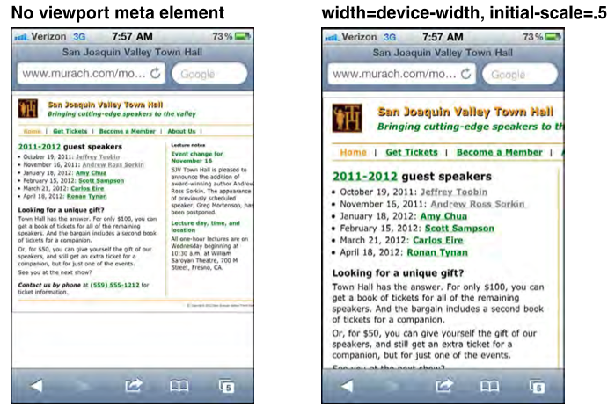
A web page on an iPhone before and after scaling

Slide 8
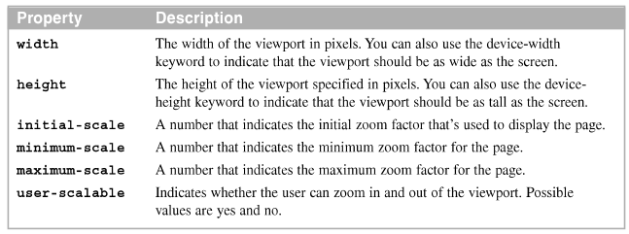
Viewport properties
Content properties for viewport metadata
Meta element that set viewport properties

Slide 9
Guidelines for designing and testing mobile web pages
Guidelines for designing mobile web pages
Keep layout simple so the focus is on the content One-column layouts typically work best
Include only essential content
Keep images small and to a minimum
Avoid using Flash
Include only the essential navigation in the header of the page
Make links and other elements large enough that the user can easily manipulate
Use relative measurements so the page looks good regardless of the scale

Slide 10
Guidelines for designing and testing mobile web pages
Guidelines for testing mobile web pages
Test all pages on as many different mobile devices and in as many different mobile browser as possible
The best way to test mobile web pages is to deploy them to your Internet server and test them on the devices themselves
Use device emulators and browser simulators

Slide 11
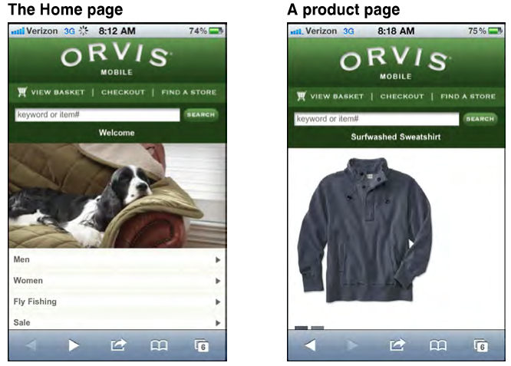
Mobile web site example
Two pages from the mobile web site for www.orvis.com

Slide 12
An introduction to jQuery Mobile

Slide 13
What jQuery Mobile is and where to get it
jQuery Mobile is a free, open-source. JavaScript library that makes it much easier to develop web sites for mobile devices. It is used combination with the core jQuery library.
The two jQuery libraries that you need
jQuery (the core library)
jQuery Mobile

Slide 14
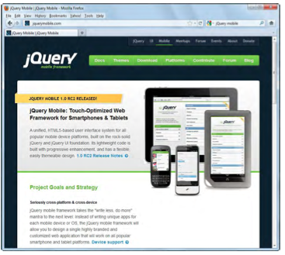
The jQuery Mobile web site
The jQuery Mobile web site (www.jquerymobile.com)

Slide 15
How to include jQuery Mobile in your web page
Use jQuery Mobile, you need include the three files: the jQuery file, the jQuery Mobile file, and the jQuery Mobile CSS style sheet.
Two ways to include the jQuery files
Include the files from a Content Delivery Network (CDN) like Microsoft or jQuery.
Download and deploy the files on your web server. Include them from the server.

Slide 16
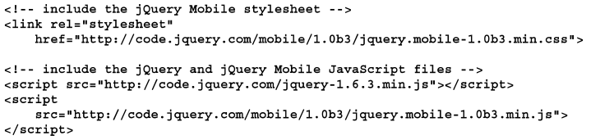
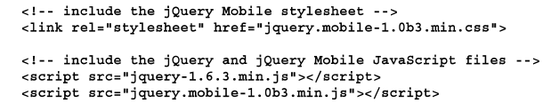
How to include jQuery Mobile in your web page
How to include the jQuery Mobile files from a Content Delivery Network
How to include the jQuery Mobile files when they’re on your web server.

Slide 17
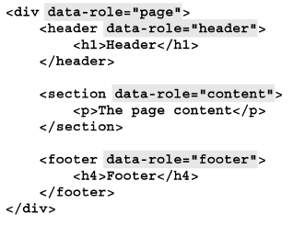
How to create one web page with jQuery Mobile
The HTML for typical web page that uses jQuery Mobile will contain div, header, section, and footer elements
The HTML for the mobile web page

Slide 18
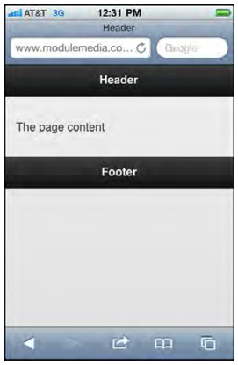
A web page that uses jQuery Mobile

Slide 19
How to use jQuery Mobile to create a mobile web site

Slide 20
How to code multiple pages in a single HTML file
The body element of a single HTML file, you code one div element for each with its data-role attribute set to “page”
The HTML for the two pages in the body of one HTML file

Slide 21
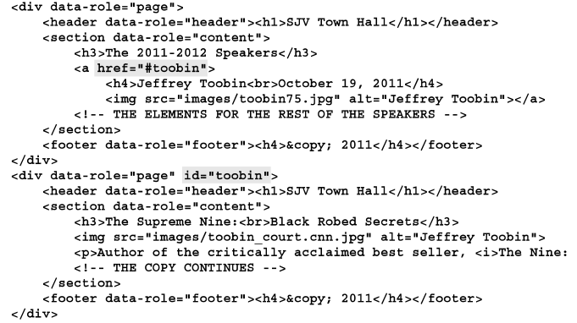
The HTML for the two pages in the body of one HTML file

Slide 22
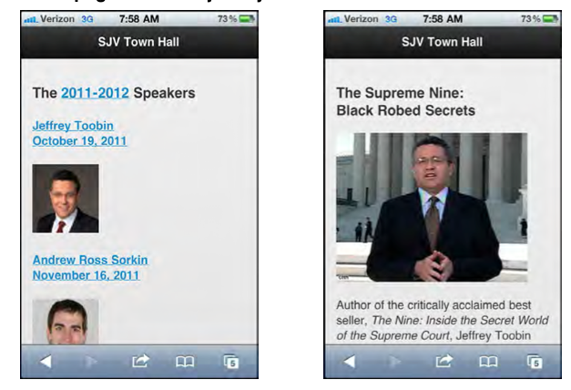
Two web pages that use jQuery Mobile

Slide 23
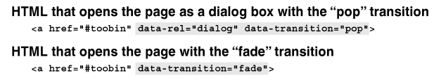
How to use dialog boxes and transitions
The HTML for a dialog box is coded the way any page is coded. In the <a> element that goes to that page, code a data-rel attribute with dialog as its values

Slide 24
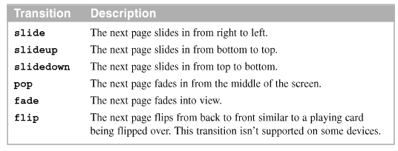
The transitions
The transitions that can be used

Slide 25
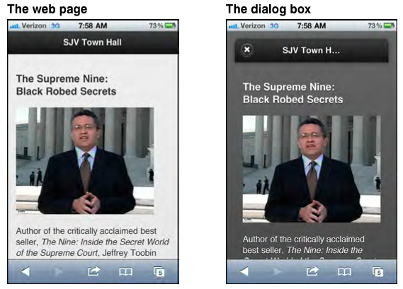
A page and a dialog box that have the same HTML

Slide 26
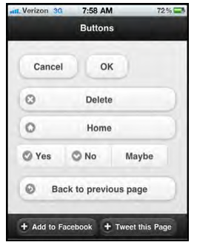
How to create buttons
To add a button to a web page, code an <a> element with its data-role attribute set “button”
A mobile web page that displays buttons

Slide 27
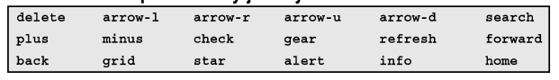
How to create buttons (cont.)
The icons that are provided by jQuery Mobile

Slide 28
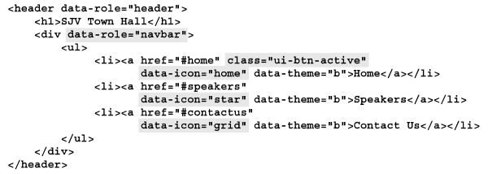
How to create a navigation bar
Add a navigation bar to a web page. Code a div element with its data-role set to “navbar”.
The HTML for the navigation bar

Slide 29
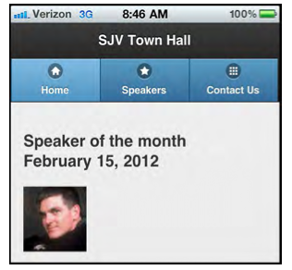
How to create a navigation bar (cont.)
A Mobile web page with a navigation bar

Slide 30
How to format content with jQuery Mobile

Slide 31
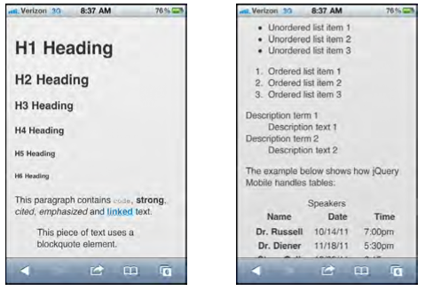
The default styles that jQuery Mobile uses
By default, jQuery automatically applies style to the HTML elements for a page.
The default styles for common HTML elements

Slide 32
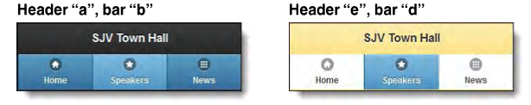
How to apply themes to HTML elements
To change the default styles that jQuery Mobile uses, use five themes that jQuery Mobile provides
Two headers and navigation bar that illustrate the use of themes

Slide 33
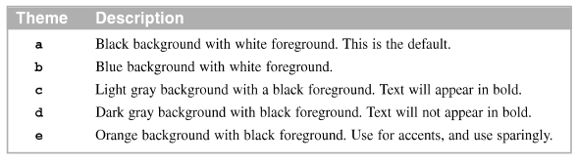
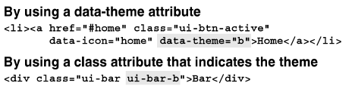
How to apply themes to HTML elements (cont.)
The five jQuery Mobile themes
Two ways to apply a theme

Slide 34
How to use jQuery Mobile for page layout

Slide 35
How to layout your content in two columns
Code a section (or div) element for the two-column area and set its class to “ui-grid-a”. Within this section, code one div element for each column, and set their classes to “ui-block-a” and “ui-block-b”. In the div elements for the columns, code the content for the columns.
A mobile web page that has two columns

Slide 36
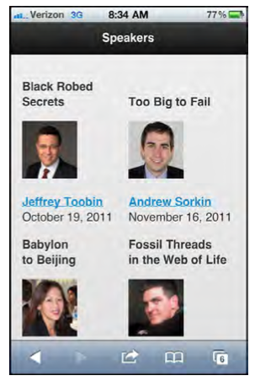

Slide 37
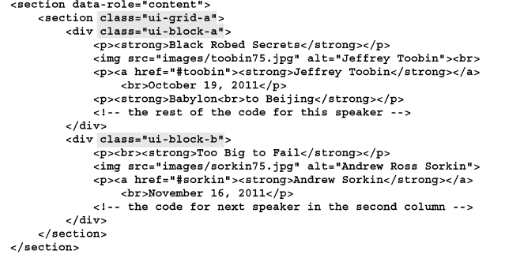
The HTML for the two columns

Slide 38
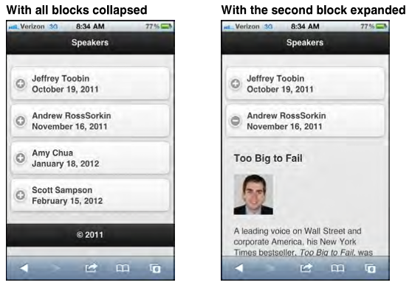
How to create collapsible content blocks
A mobile web page with collapsible content blocks

Slide 39
How to create collapsible content blocks
To code the HTML for collapsible content blocks
Code a div element for each content block with the data-role attribute set to “collapsible”
By default, each content block will be collapsed when the page is displayed. To expand a content block, add the data-collapsed attribute with its value set to “false”
Within each div element

Slide 40
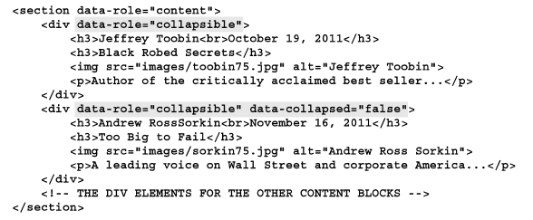
The HTML for the collapsible content blocks

Slide 41
How to create an accordion
In contrast to collapsible content blocks, only one block in an accordion can be expanded at the same time
jQuery Mobile automatically adds the plus and minus icon for the content blocks

Slide 42
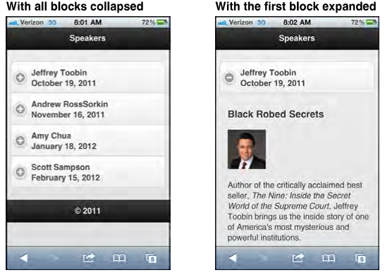
How to create an accordion
A mobile web page with an accordion

Slide 43
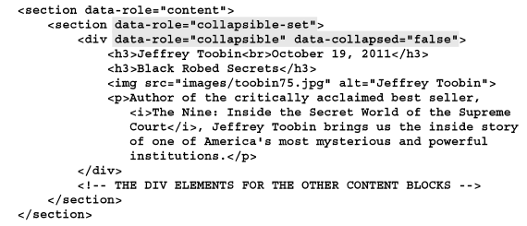
The HTML for the accordion

Slide 44
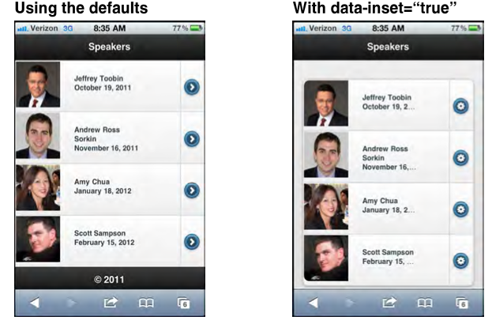
How to create a contents list
A mobile web page that displays a content list

Slide 45
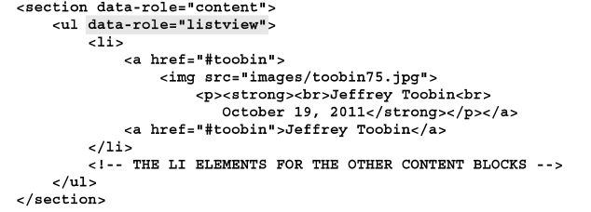
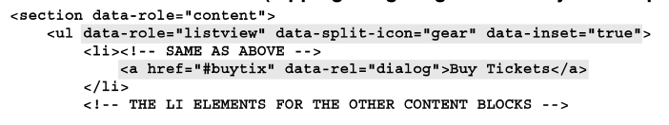
How to create a contents list
The HTML for the first list
The HTML for the seconds list

Slide 46
A mobile web site that uses jQuery Mobile

Slide 47
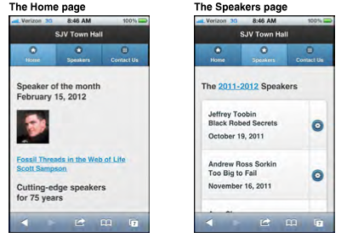
The layout for the mobile web page
The page layouts for a mobile web site that uses jQuery Mobile

Slide 48
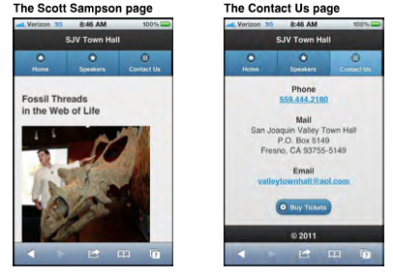

Slide 49
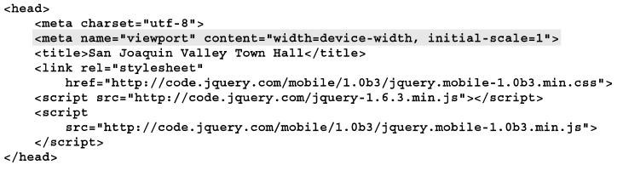
The HTML for the mobile web site
The HTML for the head section and the Home page
…………..

Slide 50
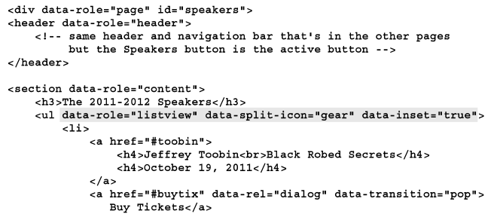
The HTML for the mobile web site
The HTML for the Speakers page
………………..

Slide 51
Summary
The best way to provide web pages for mobile devices is to build a separate web site for those devices
To redirect user to the mobile version of a web site, use JavaScript, server side, or WURFL
The viewport on a mobile device determines the content that’s displayed
jQuery Mobile is a JavaScript library that’s designed for developing mobile web sites
Notes:
Tóm tắt lại nội dung đã học
<number>

Slide 52
Bonus – Design for mobile
Method 1: Design 01 site but using CSS to format layout follow device screen.
Graphic design must be on responsive-design. See more: http://designmodo.com/responsive-design-examples/
Using “css media queries” format site
Method 2: Design difference website for mobile:
Use detectmobilebrowsers code to detect mobile device and redirect to mobile device. See more on: http://detectmobilebrowsers.com/

Slide 53
Discussion
Notes:
Trả lời câu hỏi WHY?
<number>

